Slide 1
E.S.H.S. Robotics Club

Slide 2

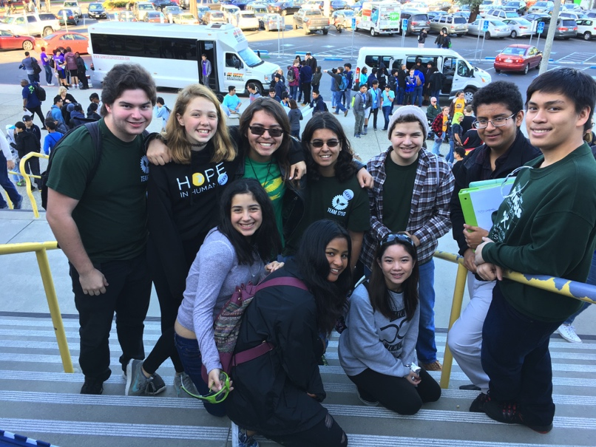
Who are we?
A legendary club that builds high-functional robots through teamwork and companionship
Notes:
Been around for ten years
Looking for members

Slide 3
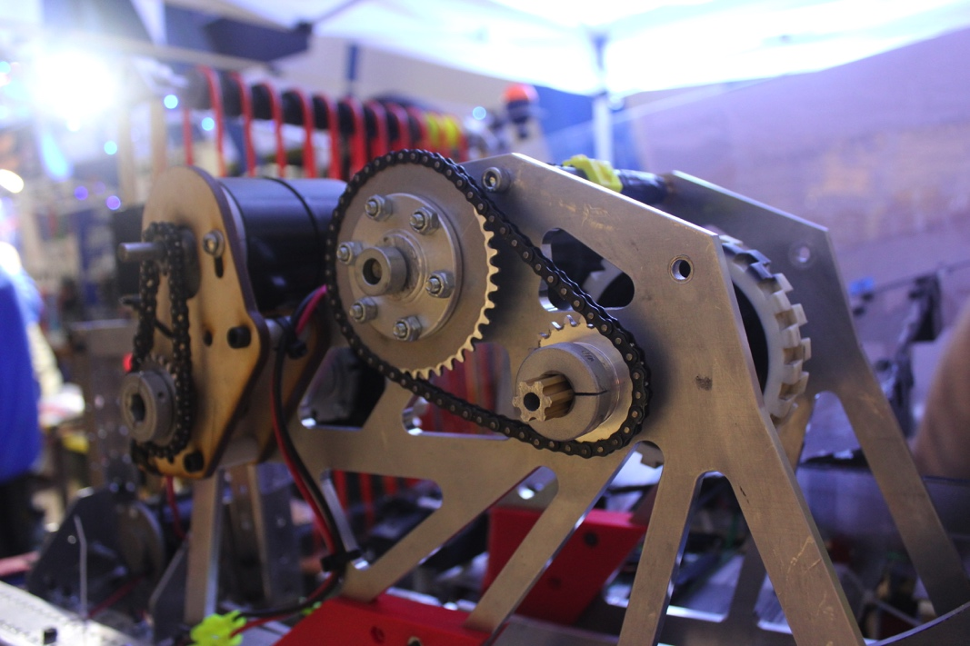
Who are we?
We build robots through many competitions and programs including:
VRC (VEX Robotics Competition)
FRC (FIRST Robotics Competition)
Computer Science
Notes:
Photo is FRC Competition
FRC open to people who have been in Robotics Club for one year

Slide 4
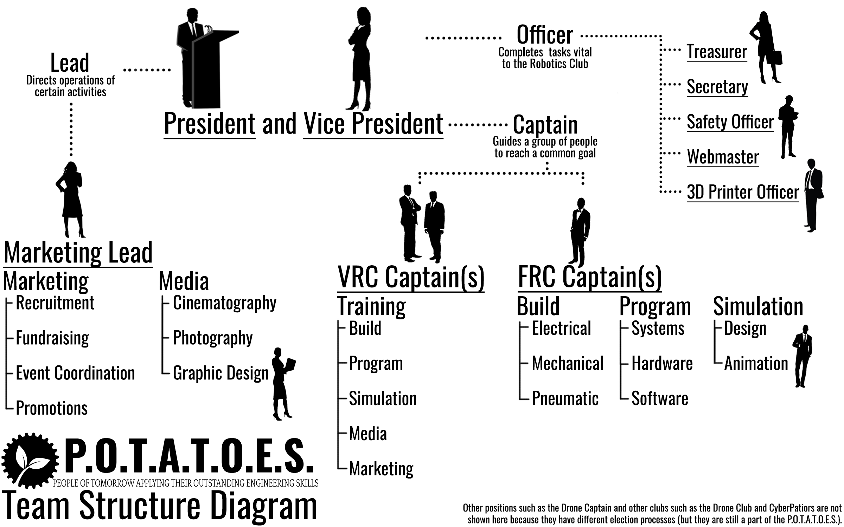

Slide 5
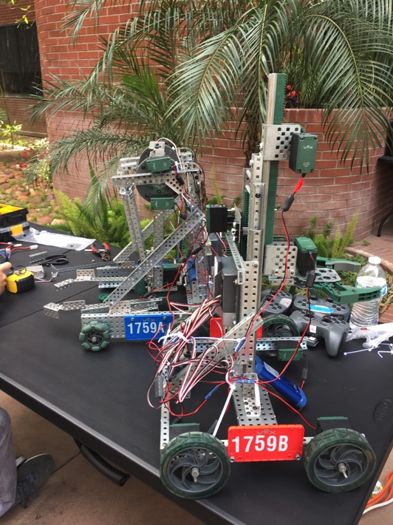
What is VRC?
Competition in which groups of 3-4 students fabricate a robot to accomplish a goal
What you will learn
Building
Programming
3D Modeling (Simulation)

Slide 6

30 Seconds of the Official VEX Trailer
https://www.youtube.com/watch?v=1Yo_mlR1VJU

Slide 7
Perks
Scholarships
200 Scholarship Providers
$50 Million Available Scholarships
Internships
Higher chance of interning if you have experience
Experience
Prestige on college applications
Obtain professional advice from dedicated mentors
Notes:
Data from FRC competition alone

Slide 8
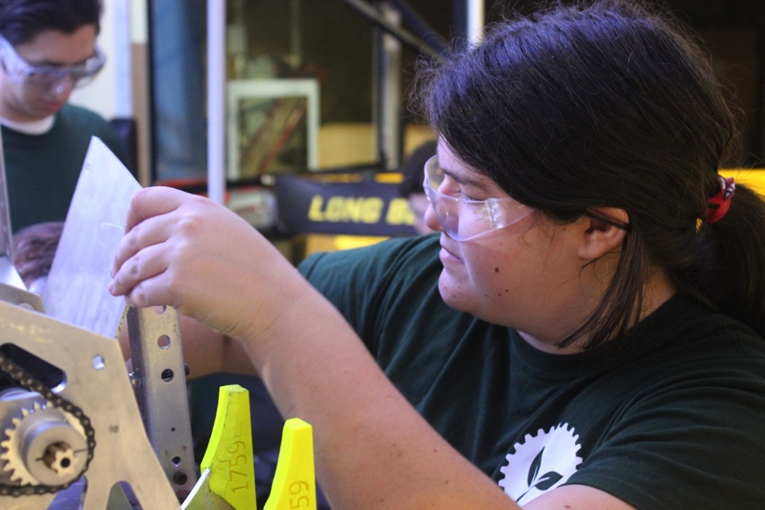
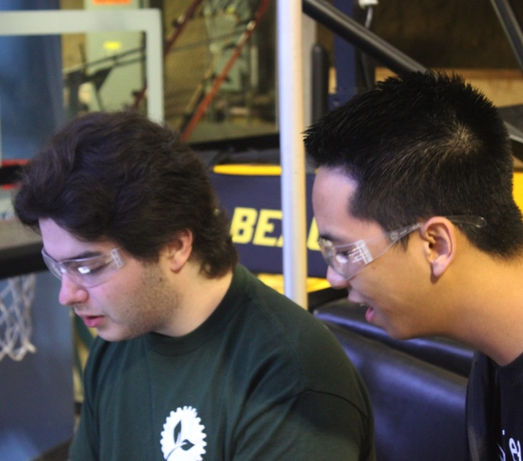
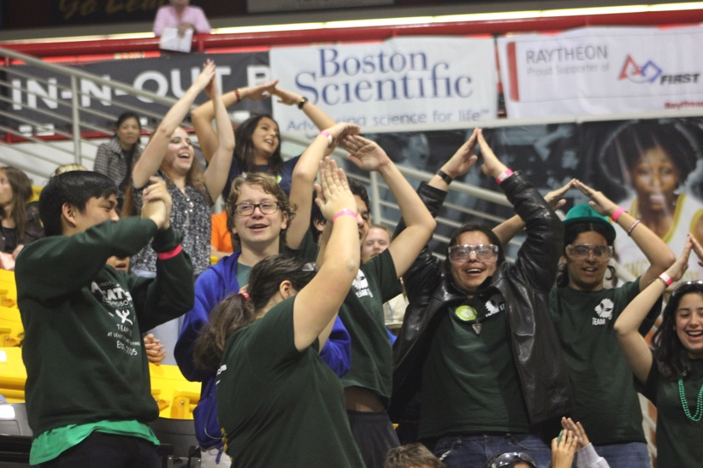
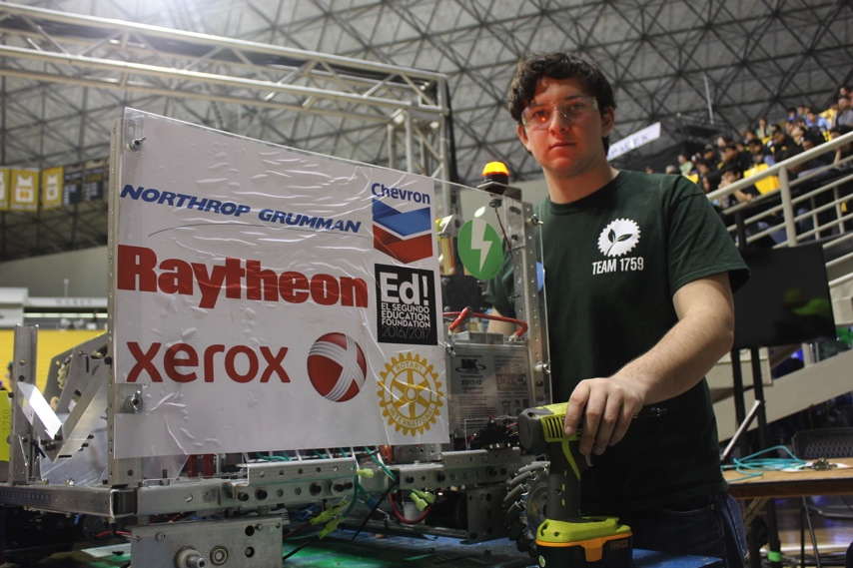

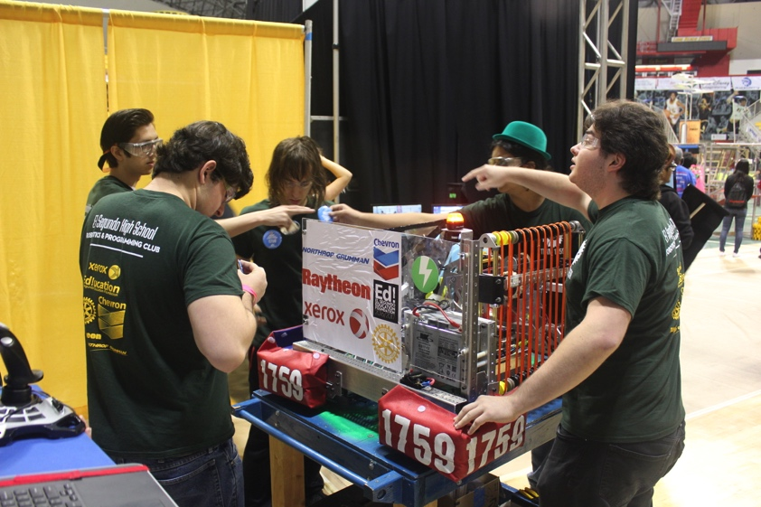
Join the vibrant E.S.H.S. Robotics community!

Slide 9
EVERY WEDNESDAY @ 3:00 IN ENGINEERING LAB
MEET US IN THE ENGINEERING LAB AT 3:00 PM
Notes:
Questions?

